Slide 1
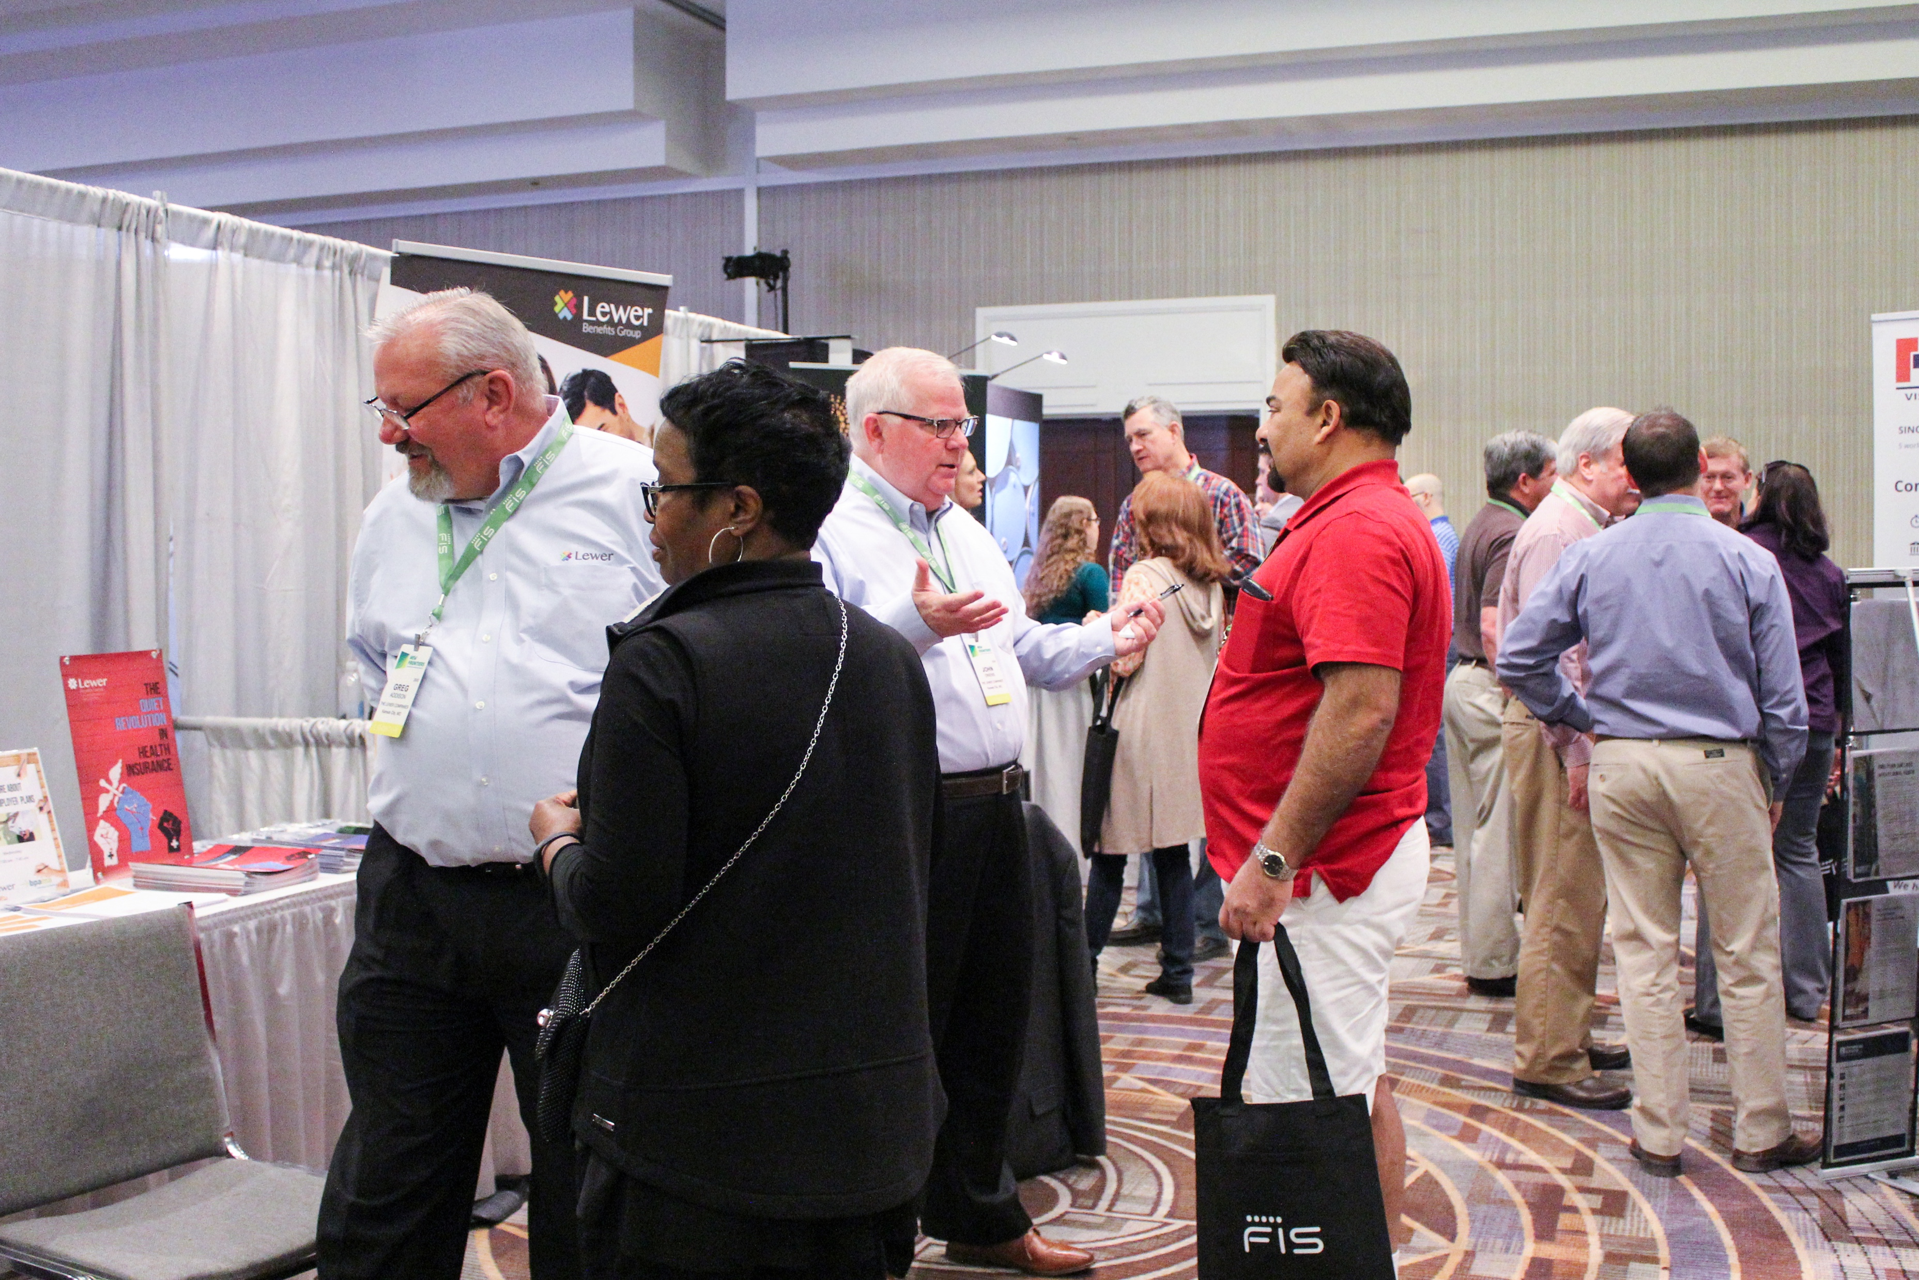
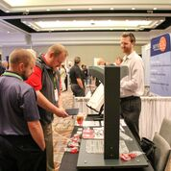
BPAMA
Affiliate Member Partnership Program
2021

Slide 2
Affiliate Member Partnership Objectives
The purpose of the Affiliate Member Partnership Program is to add value to BPAMA Members, to the Suppliers who become Affiliate Members, and to the Association
BPAMA Members will benefit through special pricing on equipment or services, through sharing of knowledge on industry issues, and through network opportunities they could not otherwise access
Affiliate Members will benefit through access to BP Marketers in traditional and creative avenues resulting in more efficient marketing opportunities
The Association will benefit by strengthening the value of BPAMA membership as well as creating an income stream to support the Association’s activities and convention

Slide 3
Affiliate Member Partnership Details
There are 3 Affiliate Member packages with varying opportunities
Gold: strategic partnership with several unique access opportunities; includes convention package
Silver: key partnership with a mix of access opportunities; includes convention package
Bronze: basic membership with a la carte options; does not include convention package
All Affiliate Members receive:
BP Marketer contact list
Inclusion in BPAMA website as Affiliate Member; searchable by goods & services
Affiliate’s name plus goods & services provided sent to BP Procurement; List sent in February each year
Ability to attend convention
Listed in BPAMA app at conventions

Slide 4
Affiliate Benefits
 | Gold | Silver | Bronze
Annual Package | $15,000 | $6,000 | $625
Logo Inclusion* | Included | Included | X
Newsletter Insert | 2 per year | 1 per year | X
Email Blast** | 2 per year | 1 per year | X
Newsletter Article | 2 per year | 1 per year | X
BP Meetings | If Applicable | After Gold | X
NLB or WC Dinner | 1 each | After Gold | X
Webinar | 1 per year | X | X
Vendor Spotlight | 1 per year | X | X
On website, quarterly newsletters, NLB minutes
** Received by all BPAMA members

Slide 5
Affiliate Convention Benefits
 | Gold ($15k) | Silver($6k) | Bronze ($625)
Booth Space ($2000 value) | 1 | 1 | X
Registrations ($3650 value*) | 6 Full, 2 Expo* | 2 Full, 2 Expo | X
Logo on Convention Website & Mobile App | Included | Included | X
E-Mail Blast Pre Conv. | Included | Included | X
Bag Insert or Equivalent | Included | Included | X
Priority Recognition | Included | X | X
VIP at Gen. Session | Included | X | X
Video pre Gen Session | Included | X | X
Podium Recognition | Included | X | X
BP Function (if held) | Included | X | X
Education Session | 1st Choice, if available | X | X

Slide 6
Affiliate Member Partnership Packages
Annual program costs
Gold Partnership Program - $15,000
Silver Partnership Program - $6,000
Bronze Member Package - $625
Annual invoices due by June 1st each year
Invoices will be sent out according to contract each year
Costs based on calendar year; prorated by quarter

Slide 7
Menu Options
Web Site Banner Ads - $100
Web Site Articles - $200
Attend Brand or Regional Meeting - $500
Article in Quarterly Newsletter - $200
Vendor Highlight - $200
Webinar - $500
NLB Meeting Dinner Sponsorship - $1000
Working Committee Dinner Sponsorship - $1000

Slide 8
Other Partnership Considerations
Promotions or discounts on goods or services for BPAMA members
Looking for value added opportunities
Discounted fees for BPAMA members
Reduced fees if applicable for members
Revenue sharing with BPAMA
Individual negotiations
Can create partnership marketing opportunities
Offset other Affiliate Member BPAMA marketing costs
Educational opportunities for products or industry

