Slide 1
February House View Update
Global Equities
Ulrike Hoffmann-Burchardi
CIO Americas and Global Head of Equities
2026 Outlook
This report has been prepared by UBS Financial Services Inc. (UBS FS). Please see required disclosures at the end of the document.
Notes:
Note to Financial Advisors
This Research Report must be used in its entirety. NEVER OMIT THE SLIDES MARKED “APPENDIX” AT THE END OF THIS PRESENTATION.” Financial Advisors may not present or use individual sections or slides in communications with clients or marketing materials.

Slide 2
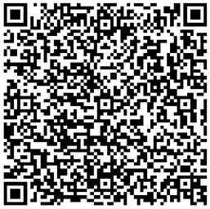
How we cover equities
Our CIO framework: Three perspectives
Macro
Macro
Real GDP growth and
real interest rates
Micro
1% of firms have created > 80% of net wealth in the global equity markets
Micro
Innovation TRIOs
  Innovation TRIOs
  Transformational Innovation Opportunities
How we cover equities
Our CIO Framework
Published: 17 October 2024
Link to publication
Source: UBS, as of September 2025
Charts and scenarios are for illustrative purposes only. Historical performance and forecasts are no guarantee for future performance.
Please see important disclaimer at the end of the document.

Slide 3
History suggests looking beyond geopolitical escalations
Macro
Markets have shown resilience to geopolitical escalations
Price evolution across oil-related geopolitical events since 1990
Oil-related disruptions tend to be short-lived across regions
Average returns across oil-related geopolitical events since 1990
Source: Refinitiv, UBS, as of 09 February 2026
Charts and scenarios are for illustrative purposes only. Historical performance and forecasts are no guarantee for future performance.
Please see important disclaimer at the end of the document.

Slide 4
Global growth set to pick up
Macro
Fiscal stimulus to boost global growth
Fiscal contribution to real GDP, in pp
Monetary policy remains supportive
Central bank target rates and CIO December 2026 forecasts, in %
Manufacturing sentiment slowly recovering
Manufacturing PMIs by region
Source: Bloomberg, Haver, UBS, as of 09 February 2026
Charts and scenarios are for illustrative purposes only. Historical performance and forecasts are no guarantee for future performance.
Please see important disclaimer at the end of the document.

Slide 5
Strong corporate earnings across the board
Micro
Robust and broad-based earnings growth expected in 2026
UBS CIO earnings per share (EPS) growth forecasts, in %
Valuations are higher than average in many regions
Consensus 12m forward P/Es
Source: DataStream, UBS, as of 02 February 2026
Charts and scenarios are for illustrative purposes only. Historical performance and forecasts are no guarantee for future performance.
Please see important disclaimer at the end of the document.

Slide 6
Structural innovation will drive equity market returns over the long run
Innovation TRIOs
Investment into AI is robust
Global AI capex in USD bn, including CIO forecasts
Investment in Power and resources is increasing
CIO forecasts for global spending in electrical infrastructure in USD bn
Longevity: We expect annual revenues in the longevity market to surge
Sales for select Longevity segments in USD bn and 2023-30 CAGR, including CIO forecasts
Source: Company data, IEA World Energy Outlook, Bloomberg NEF, Bloomberg, UBS, as of 17 September 2025
Charts and scenarios are for illustrative purposes only. Historical performance and forecasts are no guarantee for future performance.
Please see important disclaimer at the end of the document.

Slide 7
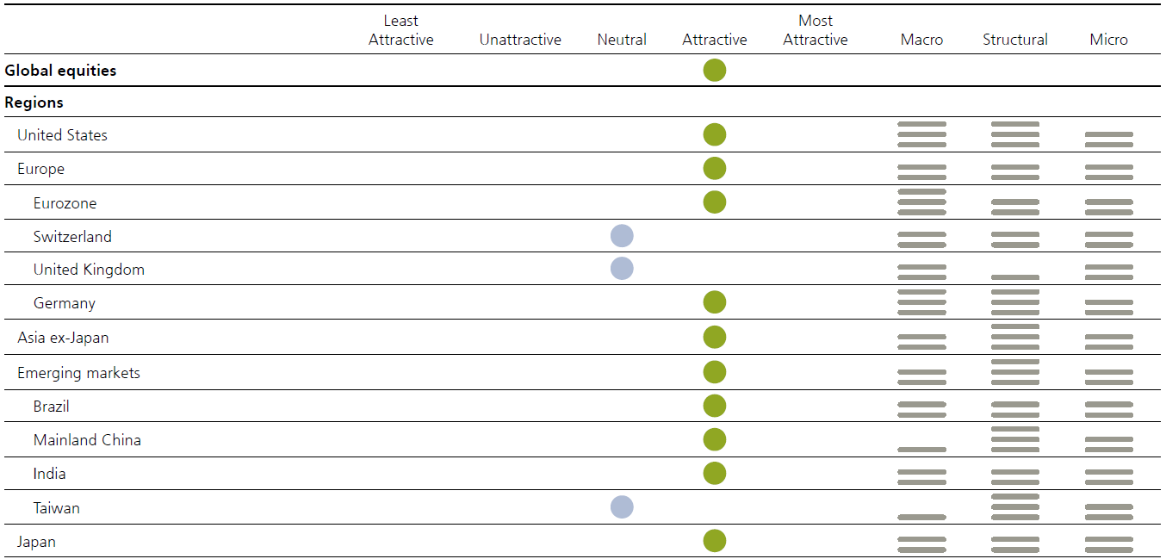
Our Equities preferences
Most attractive: We consider this asset class to be among the most attractive. Investors should seek opportunities to add exposure.
Attractive: We consider this asset class to be attractive. Consider opportunities in this asset class.
Neutral: We have a ‘neutral’ view on the asset class. No strong reason to adjust exposure.
Unattractive: We consider this asset class to be unattractive. Consider alternative opportunities.
Least attractive: We consider this asset class to be among the least attractive. Investors should seek more favorable alternative opportunities.
Note: Preferences are in local currencies and rated from least to most attractive based on absolute expected return over the next 12 months.
Arrows denote change in preference since the last UBS Equity Compass.
The asset class preferences provide high-level guidance to make investment decisions. The preferences reflect the collective judgement of the members of the House View meeting, primarily based on assessments of expected total returns on liquid, commonly known stock indexes, House View scenarios, and analyst convictions over the next 12 months. Note that the tactical asset allocation (TAA) positioning of our different investment strategies may differ from these views due to factors including portfolio construction, concentration, and borrowing constraints.
Source: UBS
Please see important disclaimer at the end of the document.

Slide 8
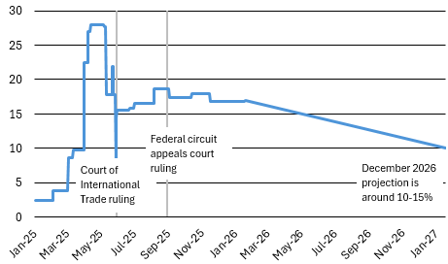
US equities: Supportive macro backdrop
Macro
Fed cuts and no recession tend to be good for stocks
S&P 500 performance since 1970, indexed
OBBBA bill to boost growth
Fiscal policy (pp contribution to real GDP growth)
Tariff headwinds to fade
US effective tariff rate and CIO forecasts in %
Source: FactSet, Bloomberg, UBS, as of 02 February 2026
Charts and scenarios are for illustrative purposes only. Historical performance and forecasts are no guarantee for future performance.
Please see important disclaimer at the end of the document.

Slide 9
US equities: Robust earnings, broader contribution
Micro
Expect earnings growth to stay robust
S&P 500 yearly earnings per share, in USD, including CIO forecasts
Earnings contribution is broadening
YoY % change in earnings, Magnificent 7 vs. Other 493 S&P 500 companies (actuals and consensus estimates)
Valuation is high but not extreme
MSCI USA, 12m forward PE and normalized performance and forward earnings
+12%
+11%
Source: FactSet, Datastream, UBS, as of 02 February 2026
Charts and scenarios are for illustrative purposes only. Historical performance and forecasts are no guarantee for future performance.
Please see important disclaimer at the end of the document.

Slide 10
US: Underpinned by structural tailwinds
Innovation TRIOs
AI: Mag7 still outgrow the rest of the market
Y/Y % change in earnings for Mag. 7 vs. Other 493 S&P 500 companies (actuals and consensus)
Power and resources: Power demand is accelerating
Total US electricity supply. In TWh
Longevity: Pharma innovation has advanced over the past decade
New FDA drug approvals
2006-15:
Avg. 29 approvals
Source: Factset, US EIA, FDA, UBS, as of February 2026
Charts and scenarios are for illustrative purposes only. Historical performance and forecasts are no guarantee for future performance.
Please see important disclaimer at the end of the document.

Slide 11
US sectors: Selective across cyclicals and defensives
Banks: Earnings drivers look poised to improve
Net interest income, S&P 500 banks, actuals and consensus ests (USD bns)
Consumer discretionary: Free cash flow generation is set to rebound
Free cash flow, S&P 500 consumer discretionary sector, actuals and consensus ests (USD mns)
Health Care: Valuations appear attractive
Health care vs. S&P 500, relative P/E based on next twelve months earnings
Source: FactSet, Bloomberg, UBS, as of 23 January 2026
Charts and scenarios are for illustrative purposes only. Historical performance and forecasts are no guarantee for future performance.
Please see important disclaimer at the end of the document.

Slide 12
Eurozone: global cyclical recovery and German fiscal spending should help
Macro
Europe to benefit from an improving cyclical backdrop
Eurozone earnings growth (lhs) and manufacturing PMI (rhs)
Germany’s fiscal boost is just beginning
German infrastructure and defense spending plans as % of GDP
European GDP to accelerate through 2026
UBS Yr/Yr GDP forecasts for Eurozone and Germany
Source: Datastream, Bloomberg, UBS, as of 09 February 2026
Charts and scenarios are for illustrative purposes only. Historical performance and forecasts are no guarantee for future performance.
Please see important disclaimer at the end of the document.

Slide 13
Eurozone: Strong earnings recovery expected
Micro
Earnings growth to pick up in 2026-2027
Euro Stoxx 50 yearly earnings per share, in EUR, including CIO forecasts
Profit margins have room to rise if volumes pick up
12m trailing EBIT margins for Eurozone equities ex financials and energy
Valuation is reasonable
MSCI EMU 12m forward PE and normalized price and forward earnings
18%
7%
Source: Datastream, Bloomberg, UBS, as of 09 February 2026
Charts and scenarios are for illustrative purposes only. Historical performance and forecasts are no guarantee for future performance.
Please see important disclaimer at the end of the document.

Slide 14
Europe: Structural markets offer upside potential
Innovation TRIOs
AI: Robust earnings growth to support European IT
European IT y/y earnings growth
Power and resources: Grid investments have more than doubled over the past two years
Announced grid investments by 23 European TSOs/DSOs. In EUR bn
Source: Factset, Gartner, WSTS, Morgan Stanley, Company reports, BofA Global Research, UBS, as of Aug 2025
Charts and scenarios are for illustrative purposes only. Historical performance and forecasts are no guarantee for future performance.
Please see important disclaimer at the end of the document.

Slide 15
Japan: PM Takaichi’s agenda is pro-growth
Macro
Takaichi’s administration is popular
Number of seats won by the ruling party at the time of dissolution and cabinet approval rating
Recent budget is pro-growth
Government budget (in tr JPY)
Source: Refinitiv, UBS, as of 09 February 2026
Charts and scenarios are for illustrative purposes only. Historical performance and forecasts are no guarantee for future performance.
Please see important disclaimer at the end of the document.

Slide 16
Japan: Structural reforms boost ROE and EPS growth
Micro
Share buybacks at all-time high
Corporates gross purchasing value since April (JPY tn)
Robust earnings support recent gains
Topix, 12-month forward EPS
Source: Refinitiv, UBS as of January 2026
Charts and scenarios are for illustrative purposes only. Historical performance and forecasts are no guarantee for future performance.
Please see important disclaimer at the end of the document.

Slide 17
EM / Asia: Supportive macro conditions
Macro
Recent central bank cuts remain a tailwind
Average price return around first Fed rate cut
Softer USD also helps
3m change in EM equities vs 3m change in DXY index
Source: Datastream, UBS as of 31 January 2026
Charts and scenarios are for illustrative purposes only. Historical performance and forecasts are no guarantee for future performance.
Please see important disclaimer at the end of the document.

Slide 18
China Tech: Strong earnings growth at reasonable valuation
Micro
Strong earnings growth expected in 2026…
Hang Seng Tech 12 months trailing EPS (lhs) and price index (rhs), including CIO estimates
Reasonable valuation, especially compared with US tech
Hang Seng Tech Index 12-month forward price-to-earnings ratio
Source: Datastream, UBS, as of 2 January 2026
Charts and scenarios are for illustrative purposes only. Historical performance and forecasts are no guarantee for future performance.
Please see important disclaimer at the end of the document.

Slide 19
EM / Asia: At the forefront of structural innovation
Innovation TRIOs
AI: China to spur tech self-sufficiency
China's self-sufficiency rate in memory and logic equipment. In %
Power and resources: Asia leads global nuclear capacity expansion
Net capacity of nuclear reactors in operation and under construction by country. In GW
Source: Morgan Stanely research, Gartner, WSTS, IAEA Power Reactor Information System, UBS, as of Mar 2026
Charts and scenarios are for illustrative purposes only. Historical performance and forecasts are no guarantee for future performance.
Please see important disclaimer at the end of the document.

Slide 20
Risk information
UBS Chief Investment Office's ("CIO") investment views are prepared and published by the Global Wealth Management business of UBS Switzerland AG (regulated by FINMA in Switzerland) or its affiliates ("UBS"), part of UBS Group AG ("UBS Group"). UBS Group includes former Credit Suisse AG, its subsidiaries, branches and affiliates. Additional disclaimer relevant to Credit Suisse Wealth Management follows at the end of this section.
The investment views have been prepared in accordance with legal requirements designed to promote the independence of investment research.
Generic investment research – Risk information:
This publication is for your information only and is not intended as an offer, or a solicitation of an offer, to buy or sell any investment or other specific product. The analysis contained herein does not constitute a personal recommendation or take into account the particular investment objectives, investment strategies, financial situation and needs of any specific recipient. It is based on numerous assumptions. Different assumptions could result in materially different results. Certain services and products are subject to legal restrictions and cannot be offered worldwide on an unrestricted basis and/or may not be eligible for sale to all investors. All information and opinions expressed in this document were obtained from sources believed to be reliable and in good faith, but no representation or warranty, express or implied, is made as to its accuracy or completeness (other than disclosures relating to UBS). All information and opinions as well as any forecasts, estimates and market prices indicated are current as of the date of this report, and are subject to change without notice. Opinions expressed herein may differ or be contrary to those expressed by other business areas or divisions of UBS as a result of using different assumptions and/or criteria. UBS may utilise artificial intelligence tools (“AI Tools”) in the preparation of this document. Notwithstanding any such use of AI Tools, this document has undergone human review.
In no circumstances may this document or any of the information (including any forecast, value, index or other calculated amount ("Values")) be used for any of the following purposes (i) valuation or accounting purposes; (ii) to determine the amounts due or payable, the price or the value of any financial instrument or financial contract; or (iii) to measure the performance of any financial instrument including, without limitation, for the purpose of tracking the return or performance of any Value or of defining the asset allocation of portfolio or of computing performance fees. By receiving this document and the information you will be deemed to represent and warrant to UBS that you will not use this document or otherwise rely on any of the information for any of the above purposes. UBS and any of its directors or employees may be entitled at any time to hold long or short positions in investment instruments referred to herein, carry out transactions involving relevant investment instruments in the capacity of principal or agent, or provide any other services or have officers, who serve as directors, either to/for the issuer, the investment instrument itself or to/for any company commercially or financially affiliated to such issuers. At any time, investment decisions (including whether to buy, sell or hold securities) made by UBS and its employees may differ from or be contrary to the opinions expressed in UBS research publications. Some investments may not be readily realizable since the market in the securities is illiquid and therefore valuing the investment and identifying the risk to which you are exposed may be difficult to quantify. UBS relies on information barriers to control the flow of information contained in one or more areas within UBS, into other areas, units, divisions or affiliates of UBS. Futures and options trading is not suitable for every investor as there is a substantial risk of loss, and losses in excess of an initial investment may occur. Past performance of an investment is no guarantee for its future performance. Additional information will be made available upon request. Some investments may be subject to sudden and large falls in value and on realization you may receive back less than you invested or may be required to pay more. Changes in foreign exchange rates may have an adverse effect on the price, value or income of an investment. The analyst(s) responsible for the preparation of this report may interact with trading desk personnel, sales personnel and other constituencies for the purpose of gathering, synthesizing and interpreting market information.
Different areas, groups, and personnel within UBS Group may produce and distribute separate research products independently of each other. For example, research publications from CIO are produced by UBS Global Wealth Management. UBS Global Research is produced by UBS Investment Bank. Research methodologies and rating systems of each separate research organization may differ, for example, in terms of investment recommendations, investment horizon, model assumptions, and valuation methods. As a consequence, except for certain economic forecasts (for which UBS CIO and UBS Global Research may collaborate), investment recommendations, ratings, price targets, and valuations provided by each of the separate research organizations may be different, or inconsistent. You should refer to each relevant research product for the details as to their methodologies and rating system. Not all clients may have access to all products from every organization. Each research product is subject to the policies and procedures of the organization that produces it. The compensation of the analyst(s) who prepared this report is determined exclusively by research management and senior management (not including investment banking). Analyst compensation is not based on investment banking, sales and trading or principal trading revenues, however, compensation may relate to the revenues of UBS Group as a whole, of which investment banking, sales and trading and principal trading are a part.
Tax treatment depends on the individual circumstances and may be subject to change in the future. UBS does not provide legal or tax advice and makes no representations as to the tax treatment of assets or the investment returns thereon both in general or with reference to specific client's circumstances and needs. We are of necessity unable to take into account the particular investment objectives, financial situation and needs of our individual clients and we would recommend that you take financial and/or tax advice as to the implications (including tax) of investing in any of the products mentioned herein.

Slide 21
Risk information
This material may not be reproduced or copies circulated without prior authority of UBS. Unless otherwise agreed in writing UBS expressly prohibits the distribution and transfer of this material to third parties for any reason. UBS accepts no liability whatsoever for any claims or lawsuits from any third parties arising from the use or distribution of this material. This report is for distribution only under such circumstances as may be permitted by applicable law. For information on the ways in which CIO manages conflicts and maintains independence of its investment views and publication offering, and research and rating methodologies, please visit www.ubs.com/research-methodology. Additional information on the relevant authors of this publication and other CIO publication(s) referenced in this report; and copies of any past reports on this topic; are available upon request from your client advisor.
Important Information About Sustainable Investing Strategies: Sustainable investing strategies aim to consider and incorporate environmental, social and governance (ESG) factors into investment process and portfolio construction. Strategies across geographies approach ESG analysis and incorporate the findings in a variety of ways. Incorporating ESG factors or Sustainable Investing considerations may inhibit UBS’s ability to participate in or to advise on certain investment opportunities that otherwise would be consistent with the Client’s investment objectives. The returns on a portfolio incorporating ESG factors or Sustainable Investing considerations may be lower or higher than portfolios where ESG factors, exclusions, or other sustainability issues are not considered by UBS, and the investment opportunities available to such portfolios may differ.
External Asset Managers / External Financial Consultants: In case this research or publication is provided to an External Asset Manager or an External Financial Consultant, UBS expressly prohibits that it is redistributed by the External Asset Manager or the External Financial Consultant and is made available to their clients and/or third parties.
USA: Distributed to US persons only by UBS Financial Services Inc. or UBS Securities LLC, subsidiaries of UBS AG. UBS Switzerland AG, UBS Europe SE, UBS Bank, S.A., UBS Brasil Administradora de Valores Mobiliarios Ltda, UBS (Brasil) Corretora de Valores S.A., UBS Asesores Mexico, S.A. de C.V., UBS SuMi TRUST Wealth Management Co., Ltd., UBS Wealth Management Israel Ltd and UBS Menkul Degerler AS are affiliates of UBS AG. UBS Financial Services Inc. accepts responsibility for the content of a report prepared by a non-US affiliate when it distributes reports to US persons. All transactions by a US person in the securities mentioned in this report should be effected through a US-registered broker dealer affiliated with UBS, and not through a non-US affiliate. The contents of this report have not been and will not be approved by any securities or investment authority in the United States or elsewhere. UBS Financial Services Inc. is not acting as a municipal advisor to any municipal entity or obligated person within the meaning of Section 15B of the Securities Exchange Act (the "Municipal Advisor Rule") and the opinions or views contained herein are not intended to be, and do not constitute, advice within the meaning of the Municipal Advisor Rule.
For country information, please visit ubs.com/cio-country-disclaimer-gr or ask your client advisor for the full disclaimer.
Additional Disclaimer relevant to Credit Suisse Wealth Management
You receive this document in your capacity as a client of Credit Suisse Wealth Management. Your personal data will be processed in accordance with the Credit Suisse privacy statement accessible at your domicile through the official Credit Suisse website. In order to provide you with marketing materials concerning our products and services, UBS Group AG and its subsidiaries may process your basic personal data (i.e. contact details such as name, e-mail address) until you notify us that you no longer wish to receive them. You can optout from receiving these materials at any time by informing your Relationship Manager.
Except as otherwise specified herein and/or depending on the local Credit Suisse entity from which you are receiving this report, this report is distributed by UBS Switzerland AG, authorised and regulated by the Swiss Financial Market Supervisory Authority (FINMA).
Version A/2026. CIO82652744
© UBS 2026. The key symbol and UBS are among the registered and unregistered trademarks of UBS. All rights reserved.

